Slide 1

QUANTOPIAN CONTEST
Juan Sebastian Peña Quintero

Slide 2
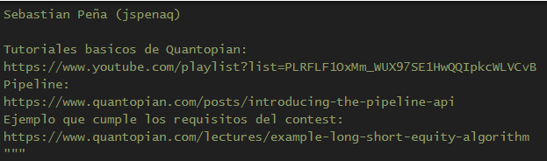
Base
Initialize(), make_pipeline(), before_trading_start(), rebalance(), record_vars()

Slide 3
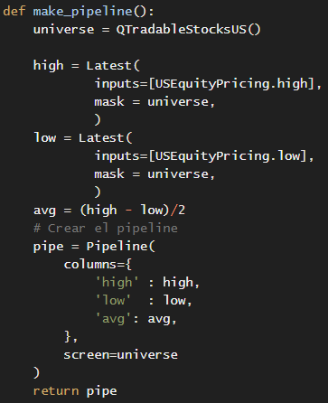
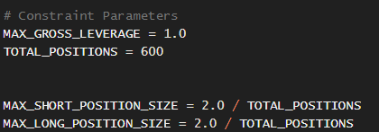
Pipeline & Constraints

Slide 4
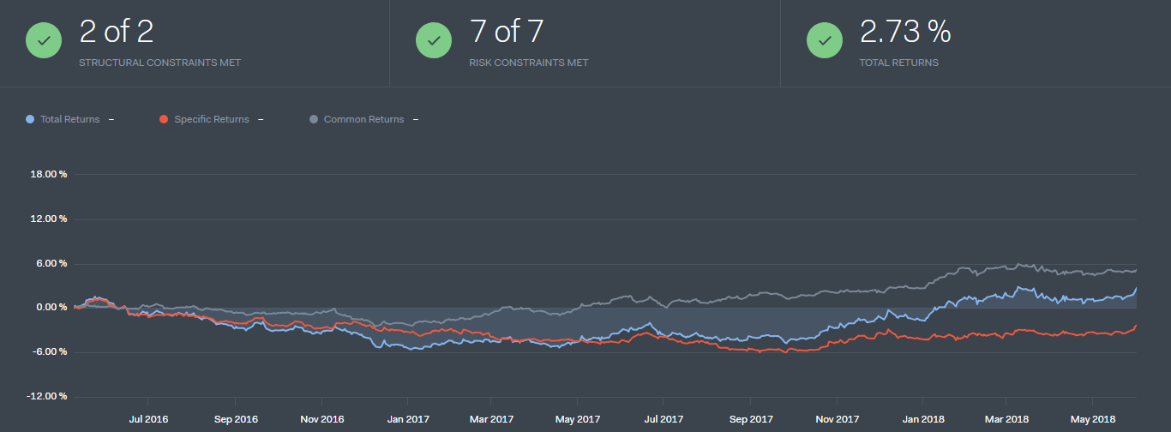
Backtest

Slide 5
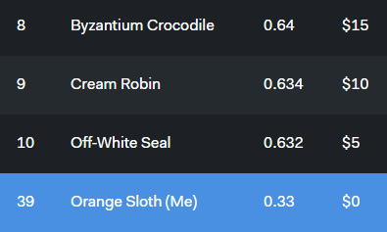
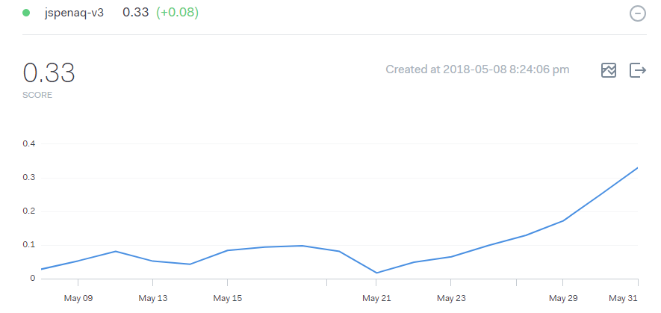
Contest

